Slide 1


Fusion
IoT | Analytics | Integration

Slide 2
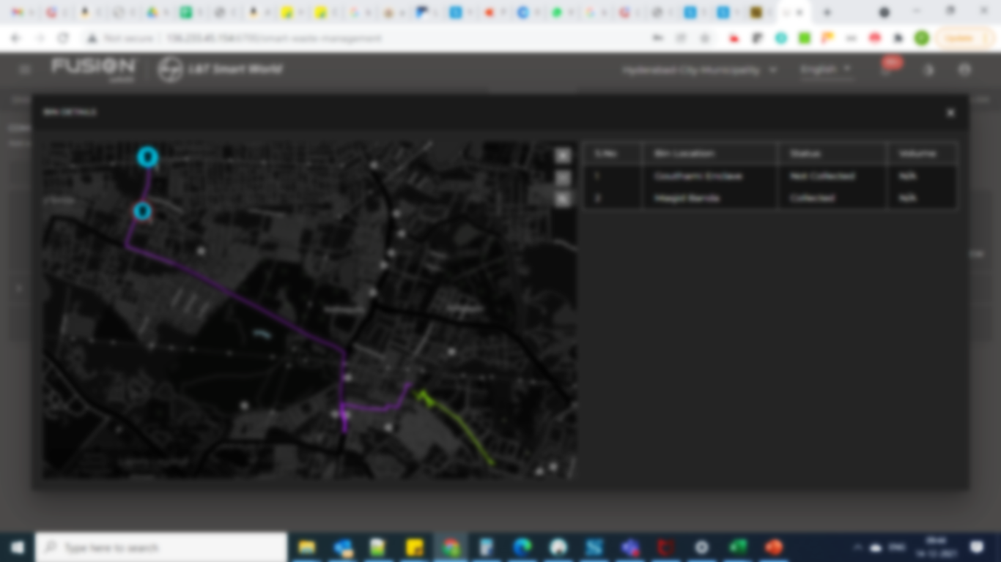


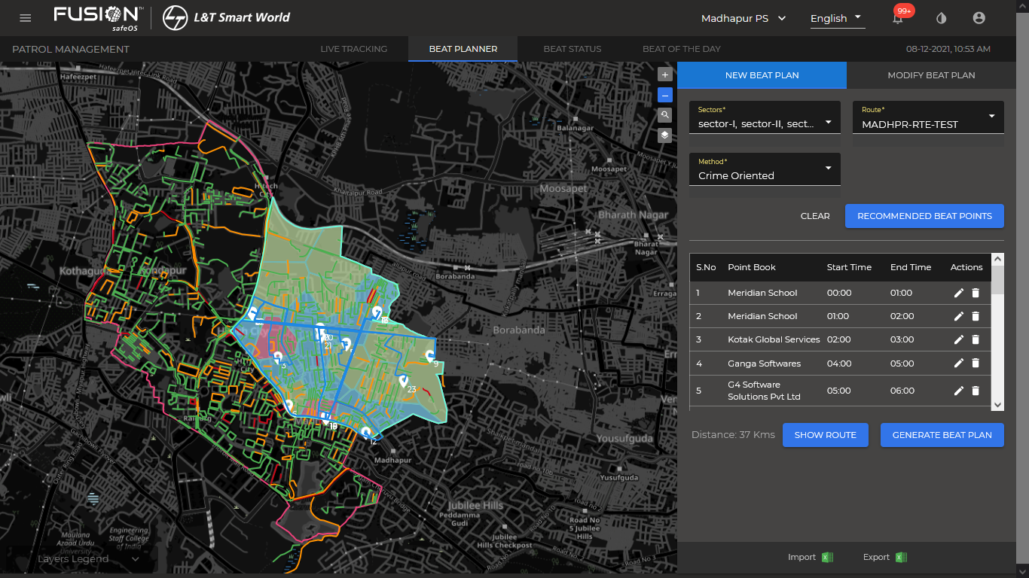







Patrol Management
Live Tracking
Beat Planner & Monitoring
Beat Route Selection & Recommendations
Incident Report & Management
Technologies
Geospatial
Machine Learning
Computer Vision
IOT
Data Visualization

Slide 3
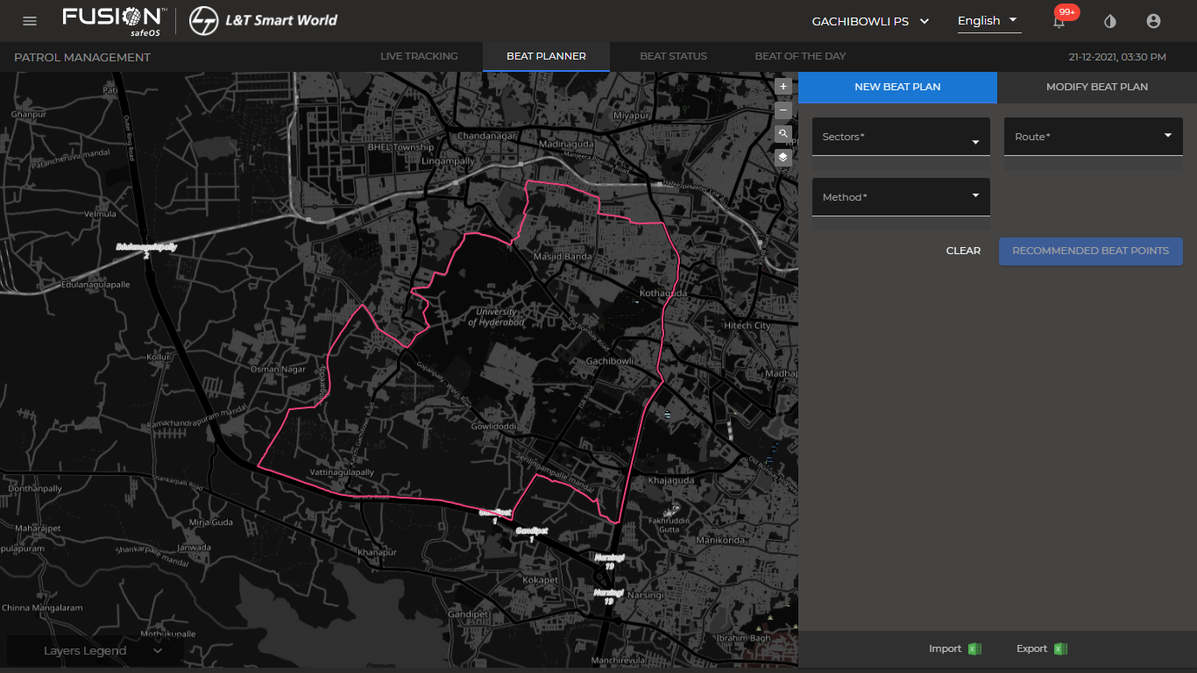
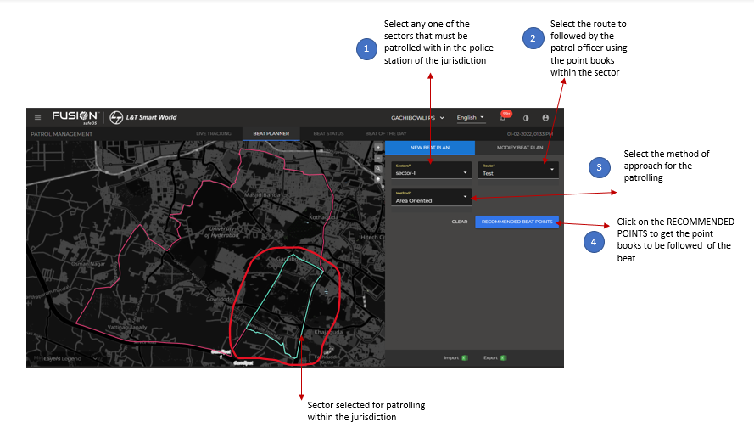
Patrol Management
Generate a beat plan

Slide 4
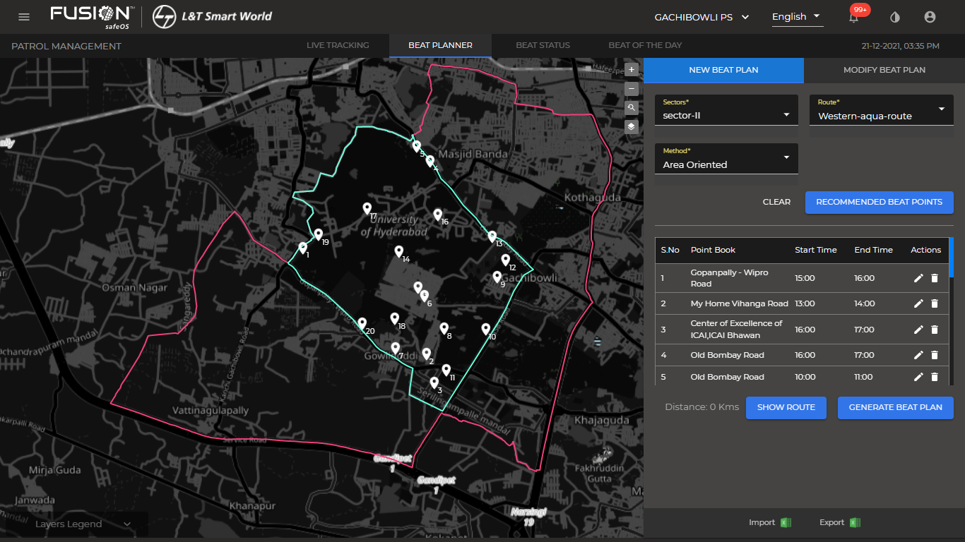
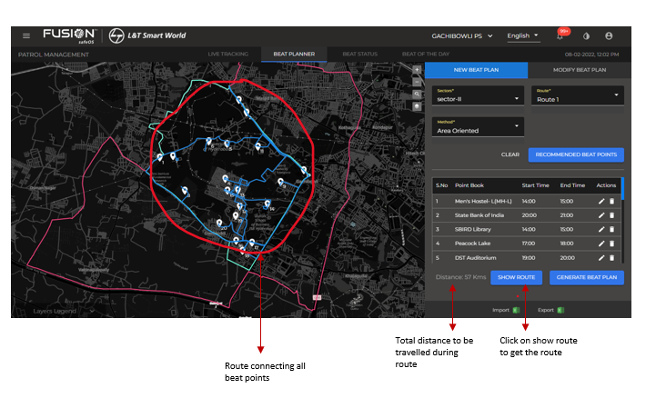
Patrol Management
Viewing beat route on map with recommended beats and routes connecting all the beats points.

Slide 5
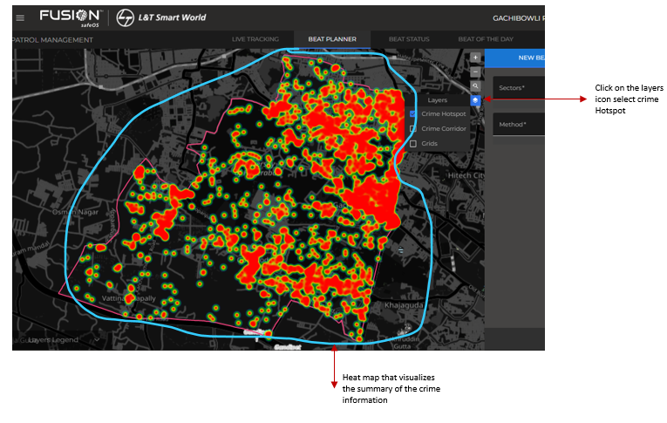
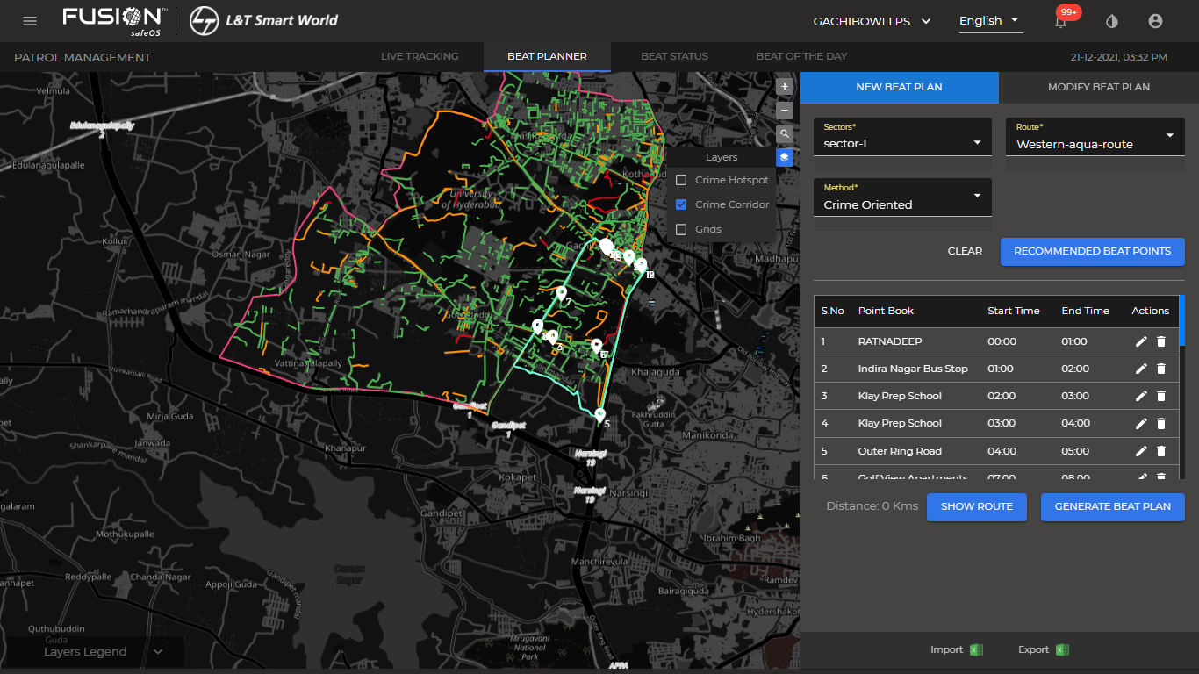
Patrol Management
Point of Interest(POI) layers on the Map
POI mapping is very useful and efficient in digital map creation as it gives detail route information with picture of crime. POI Layers in Patrol management have the following feature:
Crime Hotspots
Crime Corridors

Slide 6
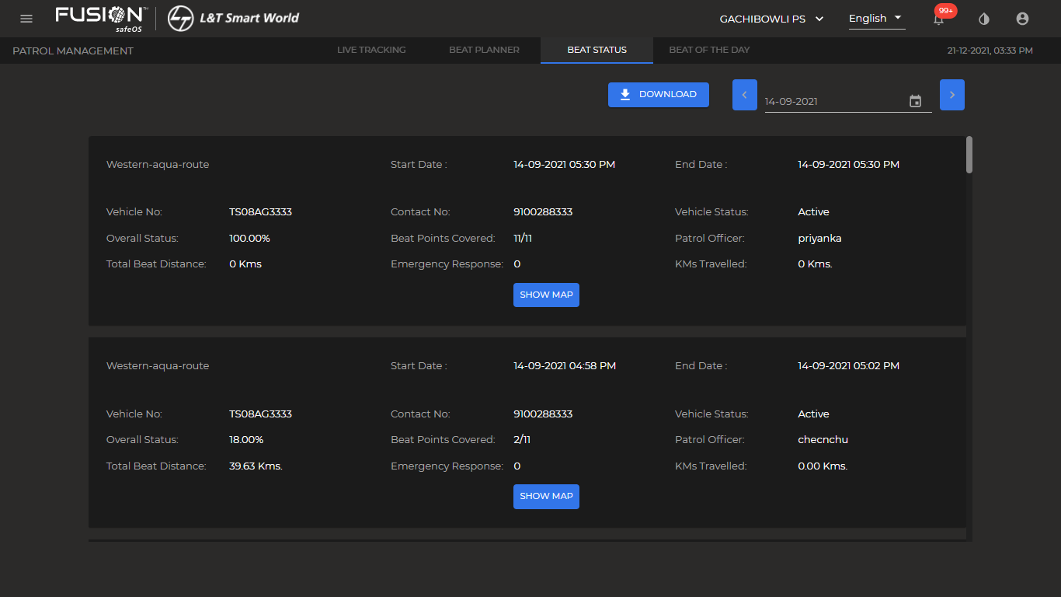
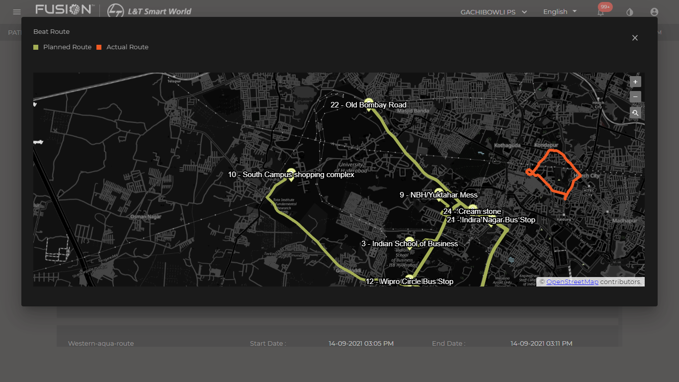
Patrol Management
Beat status with planned vs actual route comparison.

Slide 7

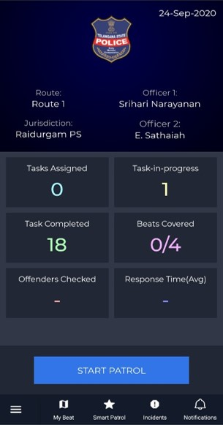
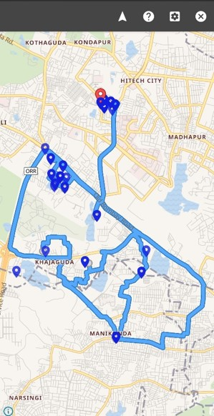
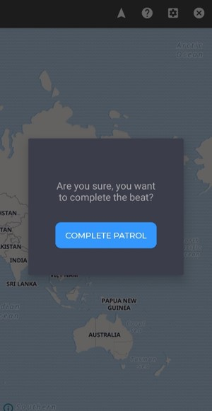
Patrol Management
Beat Patrolling
Field Officer Home Screen
Patrol Navigation
Screen
1
2
3
Beat Completion

Slide 8
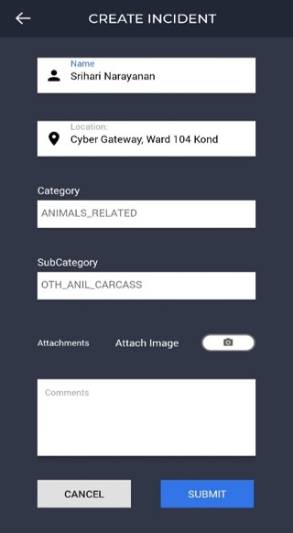
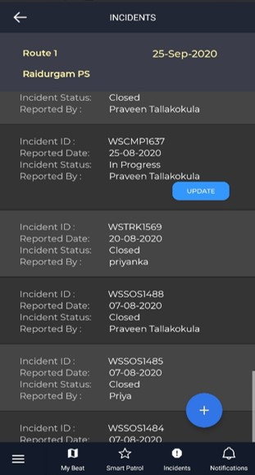
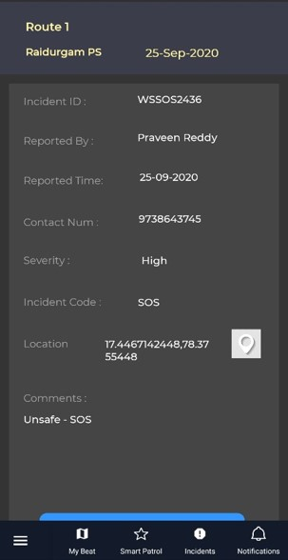
Patrol Management
Incident Report & Management
1
Create a
New Incident
Update Ongoing Incidents
2
3
Emergency Details

Slide 9
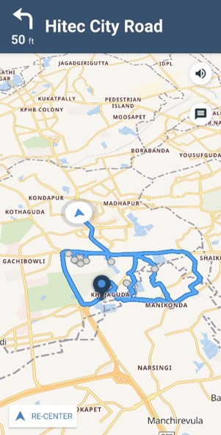
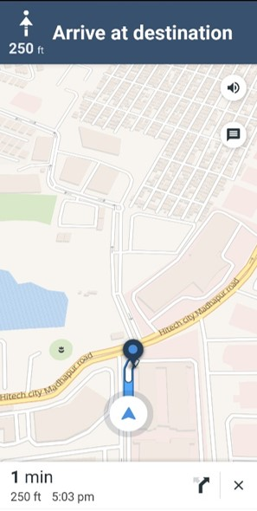
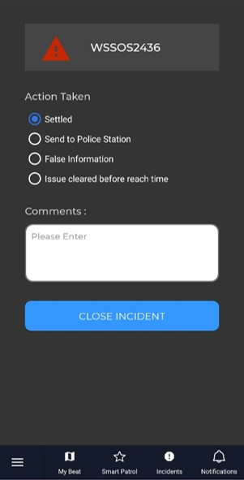
Patrol Management
Incident Report & Management
4
Route to Incident Location
5
Navigation to Incident location
6
Action Taken
Report

Slide 10
Thank you

